Slide 1

WQD7007 Big Data Management
Traditional Database

Slide 2
Database Management System (DBMS)
WQD7007 Big Data Management
DBMS contains information about a particular enterprise
Collection of interrelated data
Set of programs to access the data
An environment that is both convenient and efficient to use
Database Applications:
Banking: transactions
Airlines: reservations, schedules
Universities: registration, grades
Databases can be very large.
Databases touch all aspects of our lives
Slide credit: Silberschatz, Korth. Sudarshan, 2010 http://codex.cs.yale.edu/avi/db-book/db6/slide-dir/index.html

Slide 3
University Database Example
WQD7007 Big Data Management
WQD7007 Big Data Management
Application program examples
Add new students, instructors, and courses
Register students for courses, and generate class rosters
Assign grades to students, compute grade point averages (GPA) and generate transcripts
In the early days, database applications were built directly on top of file systems
Slide credit: Silberschatz, Korth. Sudarshan, 2010 http://codex.cs.yale.edu/avi/db-book/db6/slide-dir/index.html

Slide 4
Drawbacks of using file systems to store data
WQD7007 Big Data Management
WQD7007 Big Data Management
Data redundancy and inconsistency
Multiple file formats, duplication of information in different files
Difficulty in accessing data
Need to write a new program to carry out each new task
Data isolation
Multiple files and formats
Integrity problems
Integrity constraints (e.g., account balance > 0) become “buried” in program code rather than being stated explicitly
Hard to add new constraints or change existing ones
Slide credit: Silberschatz, Korth. Sudarshan, 2010 http://codex.cs.yale.edu/avi/db-book/db6/slide-dir/index.html

Slide 5
Drawbacks of using file systems to store data
WQD7007 Big Data Management
Atomicity of updates
Failures may leave database in an inconsistent state with partial updates carried out
Example: Transfer of funds from one account to another should either complete or not happen at all
Concurrent access by multiple users
Concurrent access needed for performance
Uncontrolled concurrent accesses can lead to inconsistencies
Example: Two people reading a balance (say 100) and updating it by withdrawing money (say 50 each) at the same time
Security problems
Hard to provide user access to some, but not all, data
Database systems offer solutions to all the above problems
Slide credit: Silberschatz, Korth. Sudarshan, 2010 http://codex.cs.yale.edu/avi/db-book/db6/slide-dir/index.html

Slide 6
Data Models
WQD7007 Big Data Management
A collection of tools for describing
Data
Data relationships
Data semantics
Data constraints
Relational model
Entity-Relationship data model (mainly for database design)
Object-based data models (Object-oriented and Object-relational)
Semistructured data model (XML)
Other older models:
Network model
Hierarchical model
Slide credit: Silberschatz, Korth. Sudarshan, 2010 http://codex.cs.yale.edu/avi/db-book/db6/slide-dir/index.html

Slide 7
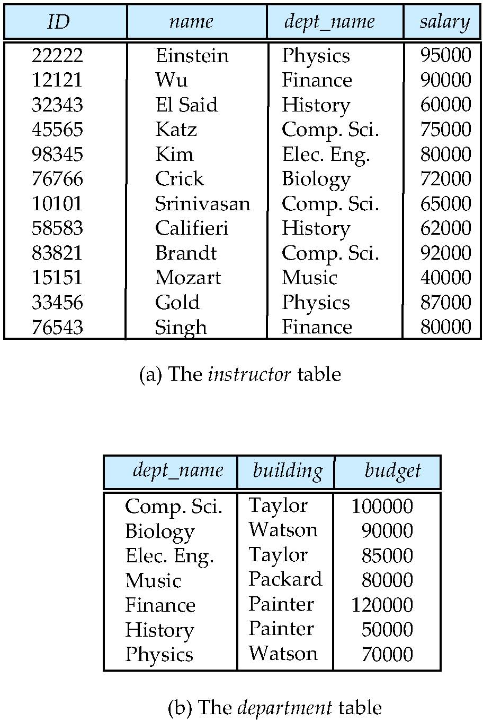
Relational model
WQD7007 Big Data Management
All the data is stored in various tables.
Example of tabular data in the relational model
Attributes (Columns)
Tuples (Rows)
Slide credit: Silberschatz, Korth. Sudarshan, 2010 http://codex.cs.yale.edu/avi/db-book/db6/slide-dir/index.html

Slide 8
A Sample Relational Database
WQD7007 Big Data Management
Slide credit: Silberschatz, Korth. Sudarshan, 2010 http://codex.cs.yale.edu/avi/db-book/db6/slide-dir/index.html

Slide 9
Keys
WQD7007 Big Data Management
Let K ⊆ R
K is a superkey of R if values for K are sufficient to identify a unique tuple of each possible relation r(R)
Example: {ID} and {ID,name} are both superkeys of instructor.
Superkey K is a candidate key if K is minimal
Example: {ID} is a candidate key for Instructor
One of the candidate keys is selected to be the primary key.
which one?
Foreign key constraint: Value in one relation must appear in another
Referencing relation
Referenced relation
Example – dept_name in instructor is a foreign key from instructor referencing department
Slide credit: Silberschatz, Korth. Sudarshan, 2010 http://codex.cs.yale.edu/avi/db-book/db6/slide-dir/index.html

Slide 10
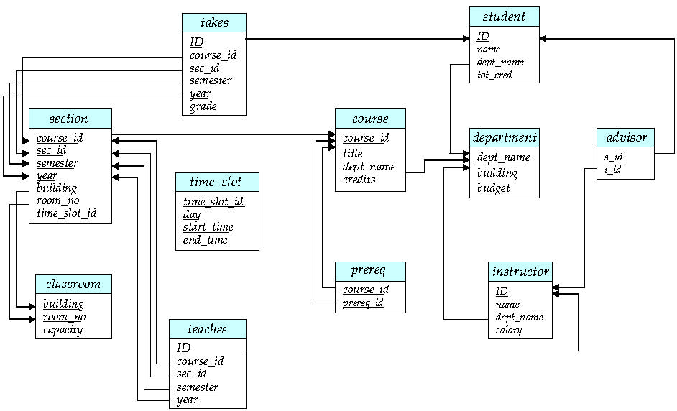
Schema Diagram for University Database
WQD7007 Big Data Management
Slide credit: Silberschatz, Korth. Sudarshan, 2010 http://codex.cs.yale.edu/avi/db-book/db6/slide-dir/index.html

Slide 11
SQL: Create Table Construct
WQD7007 Big Data Management
An SQL relation is defined using the create table command:
create table r (A₁ D₁, A₂ D₂, ..., A_{n} D_{n}, (integrity-constraint₁), ..., (integrity-constraint_{k}))
r is the name of the relation
each A_{i} is an attribute name in the schema of relation r
D_{i} is the data type of values in the domain of attribute A_{i}
Example:
create table instructor ( ID char(5), name varchar(20), dept_name varchar(20), salary numeric(8,2))
Slide credit: Silberschatz, Korth. Sudarshan, 2010 http://codex.cs.yale.edu/avi/db-book/db6/slide-dir/index.html

Slide 12
Updates to tables
WQD7007 Big Data Management
Insert
insert into instructor values (‘10211’, ’Smith’, ’Biology’, 66000);
Delete
Remove all tuples from the student relation
delete from student
Drop Table
drop table r
Alter
alter table r add A D
where A is the name of the attribute to be added to relation r and D is the domain of A.
All exiting tuples in the relation are assigned null as the value for the new attribute.
alter table r drop A
where A is the name of an attribute of relation r
Dropping of attributes not supported by many databases.
Slide credit: Silberschatz, Korth. Sudarshan, 2010 http://codex.cs.yale.edu/avi/db-book/db6/slide-dir/index.html

Slide 13
Basic Query Structure
WQD7007 Big Data Management
A typical SQL query has the form: select A₁, A₂, ..., A_{n} from r₁, r₂, ..., r_{m} where P
A_{i} represents an attribute
R_{i} represents a relation
P is a predicate.
The result of an SQL query is a relation.
Slide credit: Silberschatz, Korth. Sudarshan, 2010 http://codex.cs.yale.edu/avi/db-book/db6/slide-dir/index.html

Slide 14
The select clause
WQD7007 Big Data Management
The select clause lists the attributes desired in the result of a query
corresponds to the projection operation of the relational algebra
Example: find the names of all instructors: select name from instructor
NOTE: SQL names are case insensitive (i.e., you may use upper- or lower-case letters.)
E.g., Name ≡ NAME ≡ name
Some people use upper case wherever we use bold font.
Slide credit: Silberschatz, Korth. Sudarshan, 2010 http://codex.cs.yale.edu/avi/db-book/db6/slide-dir/index.html

Slide 15
The where clause
WQD7007 Big Data Management
The where clause specifies conditions that the result must satisfy
Corresponds to the selection predicate of the relational algebra.
To find all instructors in Comp. Sci. dept
select name from instructor where dept_name = ‘Comp. Sci.'
Comparison results can be combined using the logical connectives and, or, and not
To find all instructors in Comp. Sci. dept with salary > 80000
select name from instructor where dept_name = ‘Comp. Sci.' and salary > 80000
Comparisons can be applied to results of arithmetic expressions.
Slide credit: Silberschatz, Korth. Sudarshan, 2010 http://codex.cs.yale.edu/avi/db-book/db6/slide-dir/index.html

Slide 16
The from clause
WQD7007 Big Data Management
The from clause lists the relations involved in the query
Corresponds to the Cartesian product operation of the relational algebra.
Find the Cartesian product instructor X teaches
select ∗ from instructor, teaches
generates every possible instructor – teaches pair, with all attributes from both relations.
For common attributes (e.g., ID), the attributes in the resulting table are renamed using the relation name (e.g., instructor.ID)
Cartesian product not very useful directly, but useful combined with where-clause condition (selection operation in relational algebra).
Slide credit: Silberschatz, Korth. Sudarshan, 2010 http://codex.cs.yale.edu/avi/db-book/db6/slide-dir/index.html

Slide 17
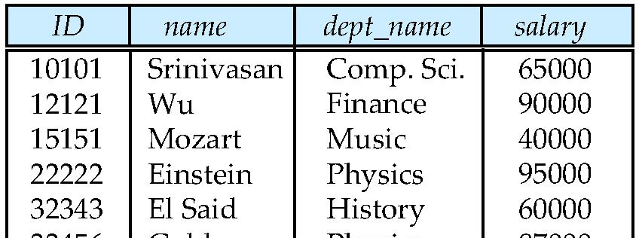
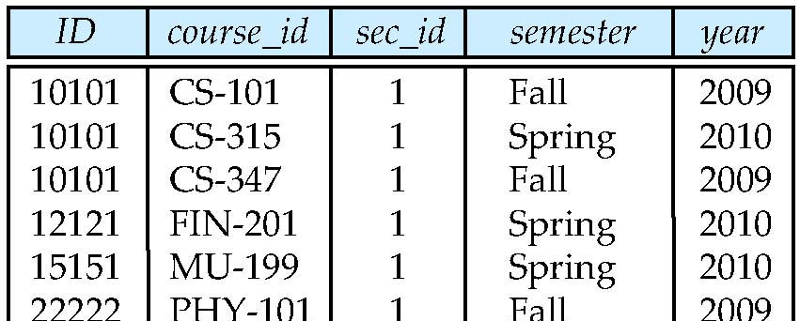
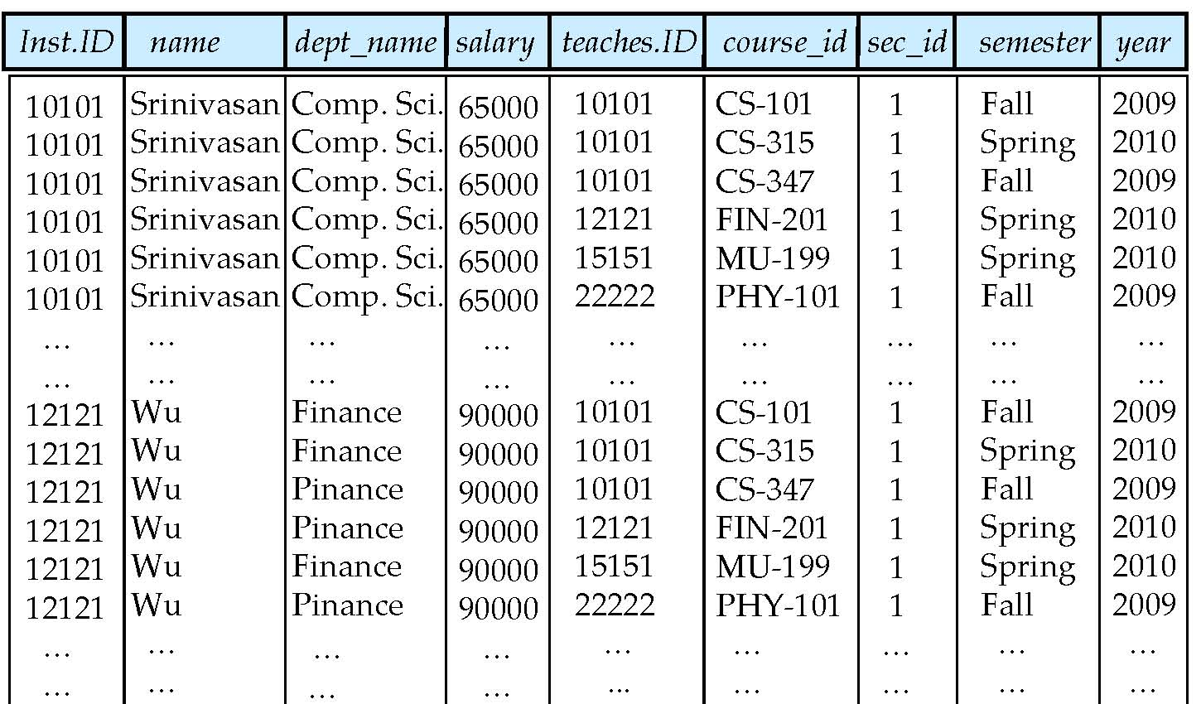
Example Table: Cartesian Product
WQD7007 Big Data Management
instructor
teaches
Slide credit: Silberschatz, Korth. Sudarshan, 2010 http://codex.cs.yale.edu/avi/db-book/db6/slide-dir/index.html

Slide 18
Examples
WQD7007 Big Data Management
Find the names of all instructors who have taught some course and the course_id
select name, course_id from instructor , teaches where instructor.ID = teaches.ID
Find the names of all instructors in the Art department who have taught some course and the course_id
select name, course_id from instructor , teaches where instructor.ID = teaches.ID and instructor. dept_name = ‘Art’
Slide credit: Silberschatz, Korth. Sudarshan, 2010 http://codex.cs.yale.edu/avi/db-book/db6/slide-dir/index.html

Slide 19
Modification in the database
WQD7007 Big Data Management
Deletion of tuples from a given relation.
Insertion of new tuples into a given relation
Updating of values in some tuples in a given relation
Slide credit: Silberschatz, Korth. Sudarshan, 2010 http://codex.cs.yale.edu/avi/db-book/db6/slide-dir/index.html

Slide 20
Deletion
WQD7007 Big Data Management
Delete all instructors
delete from instructor
Delete all instructors from the Finance department delete from instructor where dept_name= ’Finance’;
Delete all tuples in the instructor relation for those instructors associated with a department located in the Watson building.
delete from instructor where dept name in (select dept name from department where building = ’Watson’);
Slide credit: Silberschatz, Korth. Sudarshan, 2010 http://codex.cs.yale.edu/avi/db-book/db6/slide-dir/index.html

Slide 21
Insertion
WQD7007 Big Data Management
Add a new tuple to course
insert into course values (’CS-437’, ’Database Systems’, ’Comp. Sci.’, 4);
or equivalently
insert into course (course_id, title, dept_name, credits) values (’CS-437’, ’Database Systems’, ’Comp. Sci.’, 4);
Add a new tuple to student with tot_creds set to null
insert into student values (’3003’, ’Green’, ’Finance’, null);
Slide credit: Silberschatz, Korth. Sudarshan, 2010 http://codex.cs.yale.edu/avi/db-book/db6/slide-dir/index.html

Slide 22
Update
WQD7007 Big Data Management
Increase salaries of instructors whose salary is over $100,000 by 3%, and all others by a 5%
Write two update statements:
update instructor set salary = salary * 1.03 where salary > 100000; update instructor set salary = salary * 1.05 where salary <= 100000;
The order is important
Slide credit: Silberschatz, Korth. Sudarshan, 2010 http://codex.cs.yale.edu/avi/db-book/db6/slide-dir/index.html

Slide 23
Advantages of Traditional File Access
WQD7007 Big Data Management
Data Security
Safely kept and not easy to access by unauthorized personnel.
Complexity
Traditional filing systems are less complex than electronic systems, which can make it easier for untrained people to access and manipulate data.
Anyone can look through alphabetized filing cabinets to find a file. Locating and manipulating an electronic database information may require technical training, and user error can result in unintended alterations or data loss.
Source: http://smallbusiness.chron.com/advantages-disadvantages-traditional-file-organization-41400.html
Notes:
Complexity -

Slide 24
Disadvantages of Traditional File Access
WQD7007 Big Data Management
Access Time
It can take minutes if not hours to locate a few files in a large paper filing system.
Electronic databases allow for almost instantaneous access to information.
Editing and Communication
Traditional file systems are cumbersome in that they do not allow users to easily edit files or send information to others.
Paper files often cannot be edited directly, forcing users to make new copies to update old files.
Order of Data
Data can get out of order in traditional filing systems.
If someone accidentally puts a file in the wrong place, or takes a file out of a cabinet and forgets to put it back, it can lead to lost data or the creation of additional copies of files.
Source: http://smallbusiness.chron.com/advantages-disadvantages-traditional-file-organization-41400.html
Notes:
Access time - Faster data access time can increase the productivity of managers, analysts, accountants and other workers who use data on a regular basis.
-Editing and CommunicationTo distribute data on paper files, users must mail, fax or scan the data.Databases allow users to edit information fields directly, and because information is stored digitally, it is already in a form -that can be easily transmitted.
-Electronic filing systems allow users to quickly check whether information already exists somewhere in the system, which helps avoid problems like redundant files and data loss.
Disadvantage of electronic file access:
Data Security
Electronic files are usually accessible on a network, which means it's possible for an unauthorized person to gain access to electronic data over the Internet through hacking methods. Electronic data can also be damaged by software security problems like computer viruses.

Slide 25
Characteristics of existing electronic database
WQD7007 Big Data Management
Clearly defined fields organized in records. Records are usually stored in tables. Fields have names, and relationships are defined between different fields.
Schema-on-write that requires data be validated against a schema before it can be written to disk.
A significant amount of requirements analysis, design, and effort up front can be involved in putting the data in clearly defined structured formats.
This can increase the time before business value can be realized from the data.
A design to get data from the disk and load the data into memory to be processed by applications.
This is an extremely inefficient architecture when processing large volumes of data this way.
The data is extremely large and the programs are small. The big component must move to the small component for processing.
Source: http://www.pearsonitcertification.com/articles/article.aspx?p=2427073&seqNum=2
Notes:
Other characteristics:
The use of Structured Query Language (SQL) for managing and accessing the data.
Relational and warehouse database systems that often read data in 8k or 16k block sizes. These block sizes load data into memory, and then the data are processed by applications. When processing large volumes of data, reading the data in these block sizes is extremely inefficient.
Organizations today contain large volumes of information that is not actionable or being leveraged for the information it contains.

Slide 26
Question:
WQD7007 Big Data Management
What is the major difference between traditional electronic database system (e.g. RDBMS) and Big Data database system (e.g. HDFS in Hadoop)?

Slide 27
Concluding Remarks
WQD7007 Big Data Management
This lecture is to give a feel how traditional database looks like, and how to retrieve and update information inside a traditional electronic database, using SQL language.
Comparison between traditional and modern (electronic) data access, and between traditional electronic database and big data database is discussed.

